Slide 1
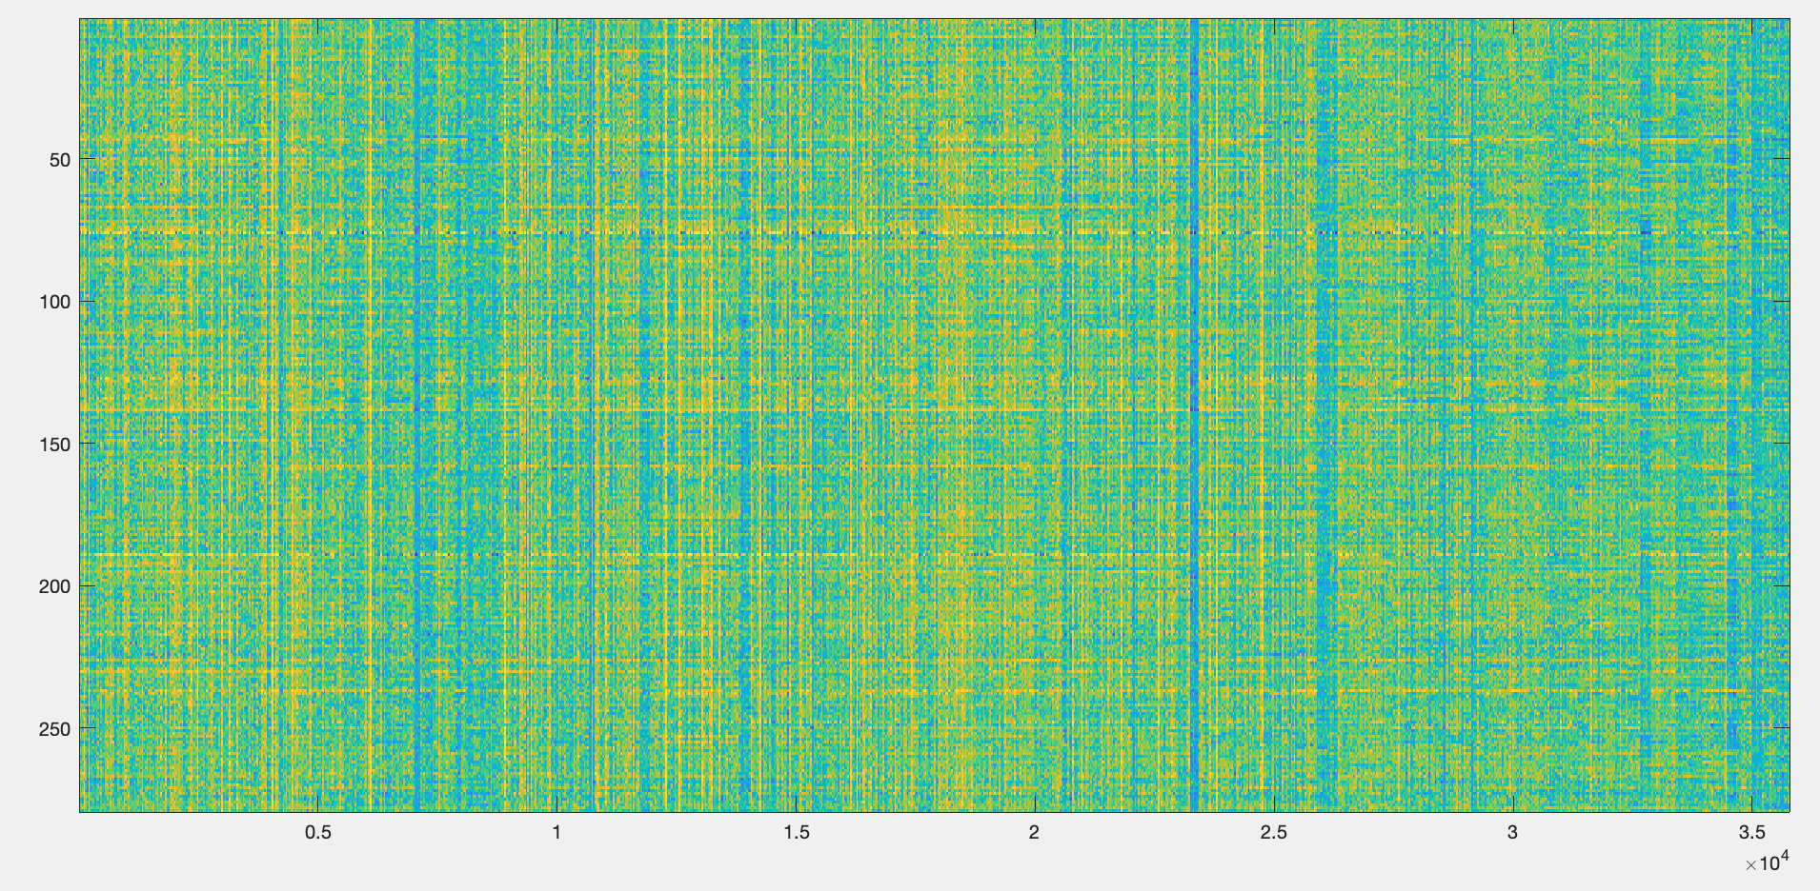
How the data is structured?
Connectivity features
All samples

Slide 2
How the data is structured?
N= 268
Feature vector of size
N * (N-1)/2 = (268* 267)/2 = 35778
Vectorize the off-diagonal upper triangular part of this matrix
(exclude diagonal)
268 brain regions
Brain graph adjacency matrix
You might need to anti-vectorize ==> transform the feature vector back to an adjacency matrix.

